Slide 1

SmartHire
Resume-to-Job Matching & Career Guidance Engine — a compact, production-ready ML portal that evaluates student CVs, returns ranked job matches, fit scores, and actionable skill-gap reports. Presented by M. Harsath Abinav, Department: AIDS.

Slide 2


Project summary
What SmartHire does
Accepts resumes (PDF/DOCX/Text), extracts and preprocesses text.
Generates ranked job matches with Top-N scoring and a shortlisting (fit) metric.
Produces a skill-gap report with prioritized suggestions for CV improvement.
Built from public resume and job datasets — uses classical ML only (no generative models).
Designed for students and early-career candidates; recruiters and ML stakeholders can validate performance metrics and pipeline modularity.

Slide 3
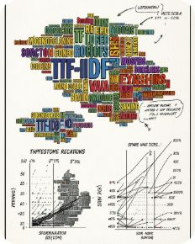
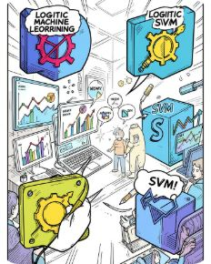
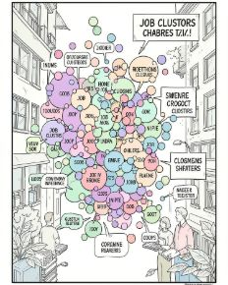
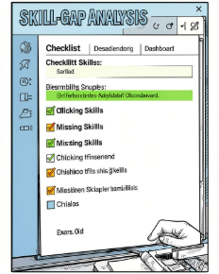
Machine learning approach
Text representation
Supervised models
Unsupervised & similarity
Skill-gap detection
TF‑IDF vectorization for resumes and job descriptions with feature engineering: n‑grams, role-specific tokens, and normalized experience/education fields.
Resume category classifier using Logistic Regression / Random Forest / SVM. Optional fit predictor combining feature-based signals (skill overlap, experience, education) and similarity scores.
Cosine-similarity recommender on TF‑IDF vectors for Top‑N matches. Job clustering via K‑Means or hierarchical methods to surface role families and diversify suggestions.
Compares candidate skill tokens to role-important skill sets; ranks gaps by impact and suggests concrete upskilling steps and CV phrasing improvements.

Slide 4


System architecture & data flow
Implementation notes
Text extraction: robust PDF / DOCX parsers with fallback heuristics for layout noise.
Preprocessing: normalization, stopword tuning, named-entity extraction for skills, experiences, and education.
Serving: lightweight Streamlit or Flask front end; models serialized with joblib or ONNX for portability.
Observability: logging for predicted labels, similarity scores, and user feedback to enable continuous retraining.
Upload Resume
Extract Text
Preprocess
TF‑IDF Vectorize
A modular pipeline that separates extraction, representation, modeling, and UI for maintainability and iterative improvement.
Privacy: strip PII by default and support opt-in data retention for model improvement.

Slide 5



Timeline, evaluation & expected outcome
1
2
3
Week 1 — Data & classifier
Week 2 — Recommender & gaps
Week 3 — Integration & delivery
Collect/clean datasets, exploratory analysis, TF‑IDF pipeline, baseline resume category classifier and initial evaluation (accuracy, ROC‑AUC).
Build similarity-based Top‑N recommender, run clustering for role families, implement skill-gap detection and human-readable suggestions.
Integrate components in Streamlit/Flask, add UI for upload and reports, prepare final documentation, evaluation artifacts and a demo presentation.
Evaluation metrics & success criteria
Classification: Accuracy, Precision, Recall, F1, ROC‑AUC, confusion matrix.
Recommender: Precision@K, Mean Reciprocal Rank (MRR), and qualitative relevance from user feedback.
Clustering: Silhouette score and cluster interpretability for role families.
Outcome: A functional portal where users upload a CV and receive ranked jobs, a fit score, and a prioritized skill-gap report.
Next steps: schedule a stakeholder demo, collect pilot user feedback, and iterate models with labeled outcomes to improve Precision@K.

